Slide 1

HACKNIGHT
Team code bust

Slide 2
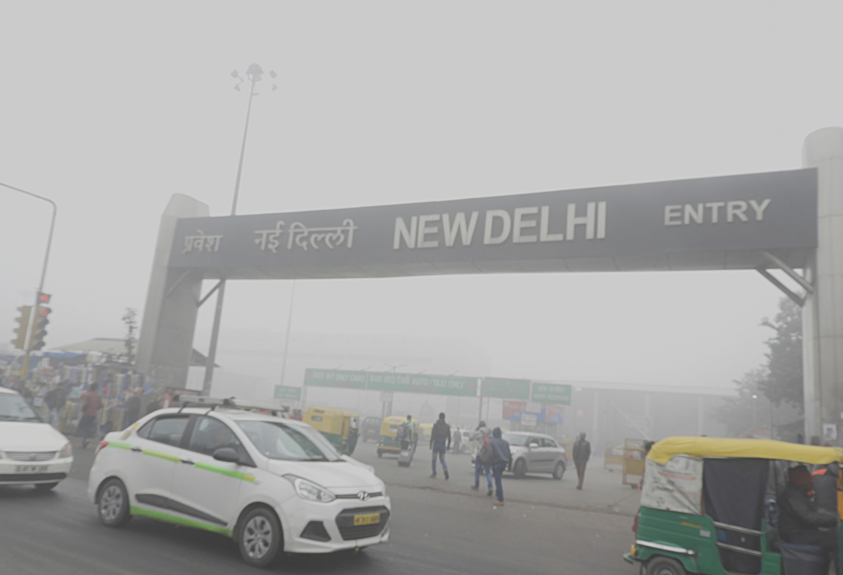

Everyone has seen this familiar sight, but have you ever wondered how much does this affect everyone?

Slide 3

Everyone is quite familiar that air pollution causes respiratory problems

Slide 4
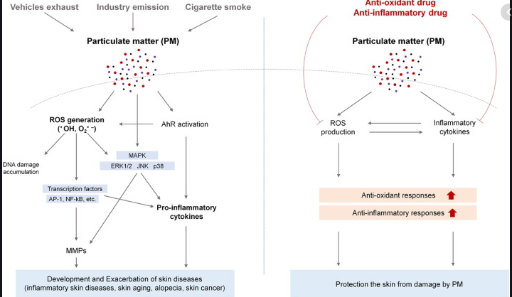
But what you might not know is that it also is a major source of skin diseases including skin cancer

Slide 5
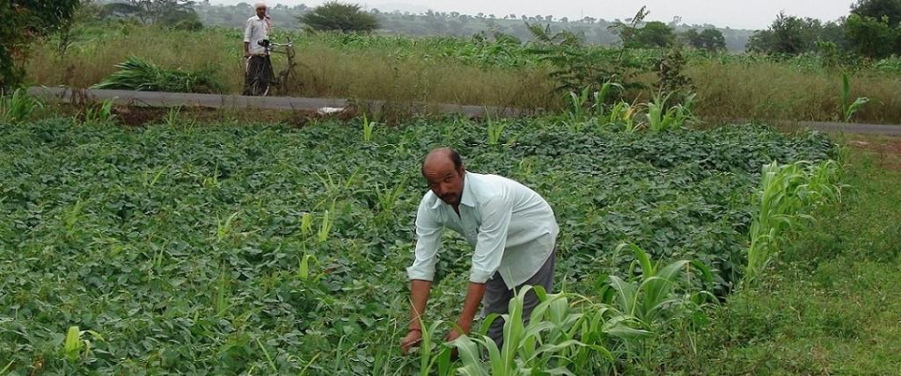
Farmers who work throughout the day are prone to the harmful UV radiation.

Slide 6
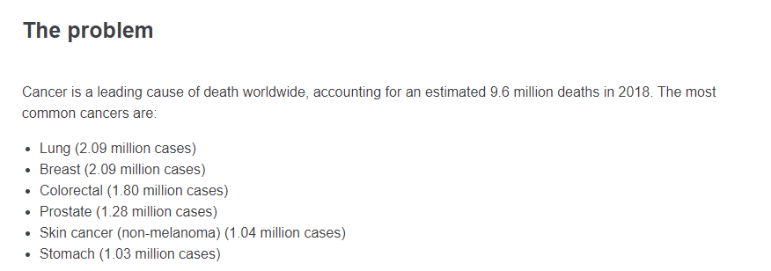
According to WHO, it is the 5th most common type of cancer!

Slide 7
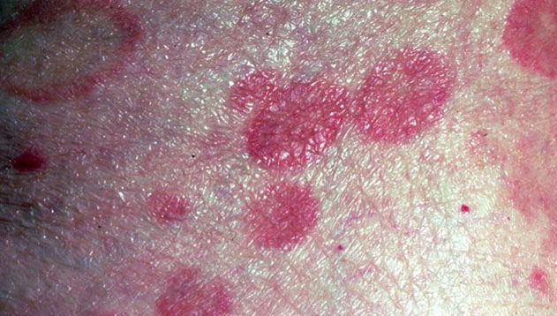
But the issue is, it can resemble a lot of the other skin diseases! And could be ignored for other less potent diseases

Slide 8

We need an efficient system which can detect if a skin sample has cancer or not!

Slide 9
Our Solution
We built a machine learning model to detect if a skin sample has cancer or not using Azure Cognitive Services
We deployed a web application using Azure Pipeline and Virtual machine to upload an image of the skin sample.
It gives prediction % of the possibility of that skin sample to have cancer.

Slide 10





Technology Stack
Azure Cognitive Services
C#
Javascript
Azure Pipeline
Bootstrap

Slide 11
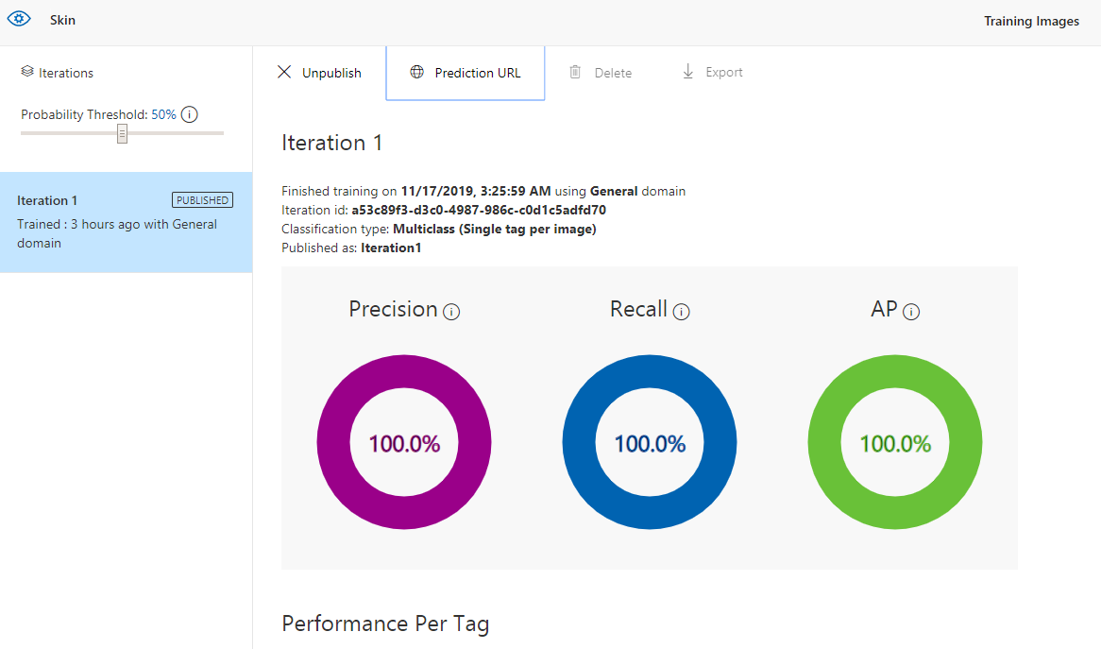
A brief on Azure Custom Vision AI
Computer vision model by simply uploading and labeling a few images.
The model tests itself on these and continually improves precision through a feedback loop as user add new images.
In our use case we added images with labels of cancer, noncancer of the skin
The model was trained using this multiclass set of images and tested to predict any new sample of images.

Slide 12
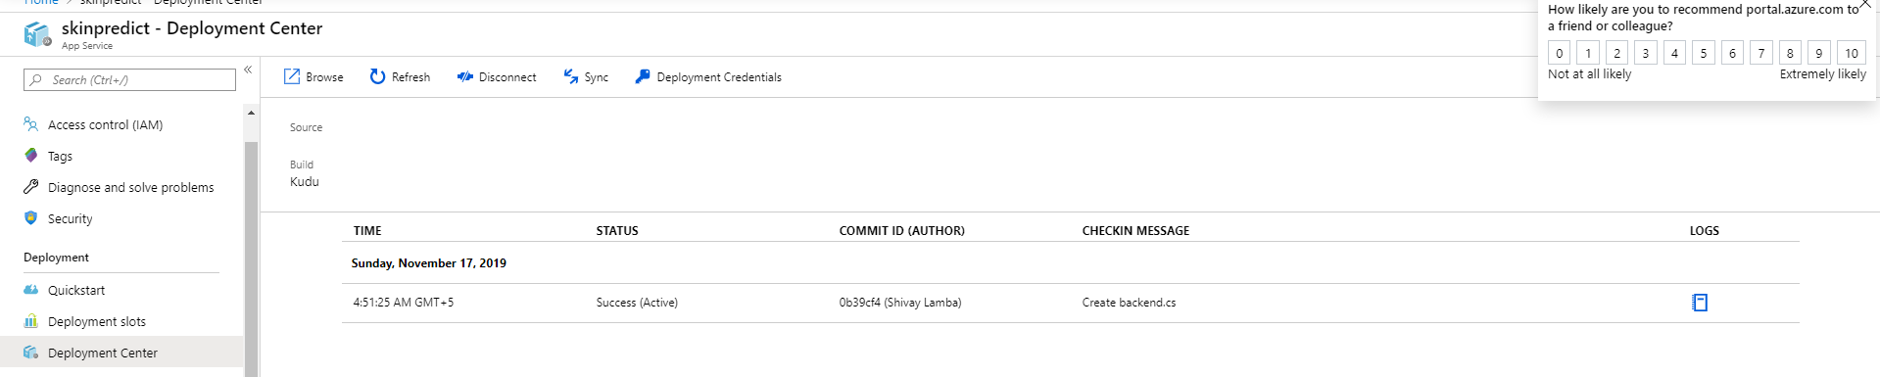
A brief on our Web application
Web app was made using Javascript and Bootstrap
The server side is written in C# which is deployed using Azure Pipeline and connected to the github repository
It calls the API end point of Azure Custom Vision AI to predict results on the image
And displays the result on the web app

Slide 13
Future Prospective
If the image is of very less quality, we can use concept of GAN to improve our image resolution.

Slide 14
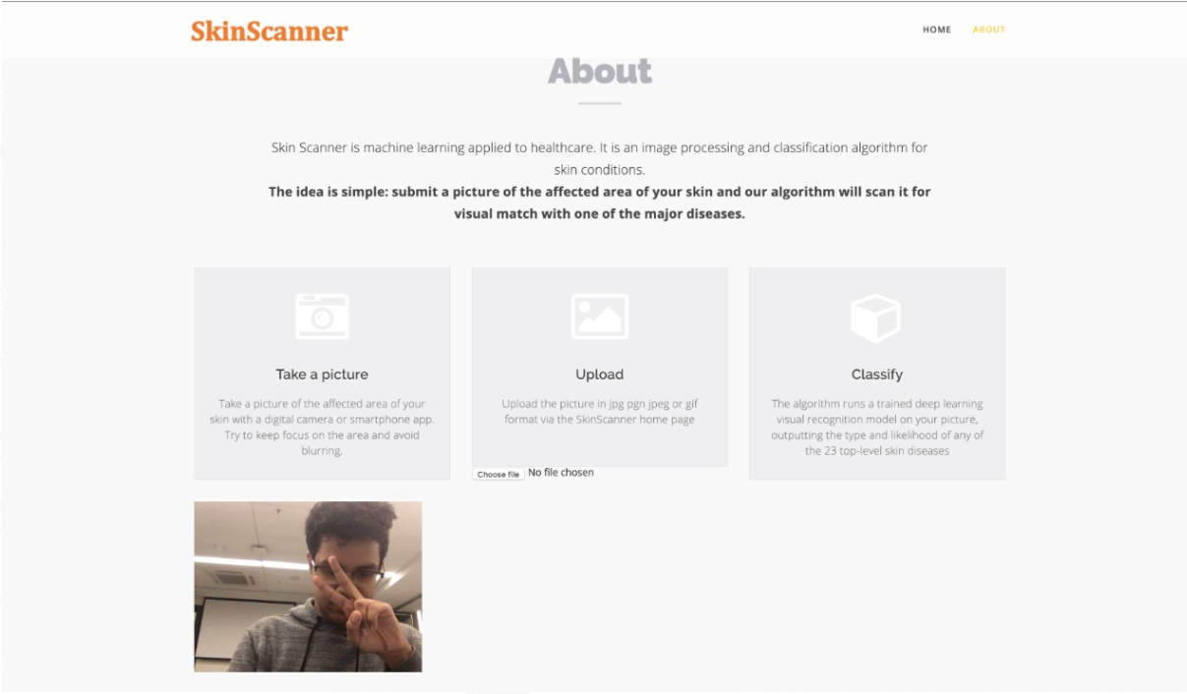

Implementation

